Slide 1


Slide 2

Contents
Introduction
Geographical locations and stats
Reviews and Heat Mapped Ratings
Visitor Experience and Revenue
Demonstration

Slide 3

Introduction
Purpose
Market Museums as Travel Hotspots (for National & International Tourists)
Audience
United States Travel and Tourism Administration
Dashboard
High level view of locations
Heatmap to reviews
View of revenue generation, and visitor experience

Slide 4
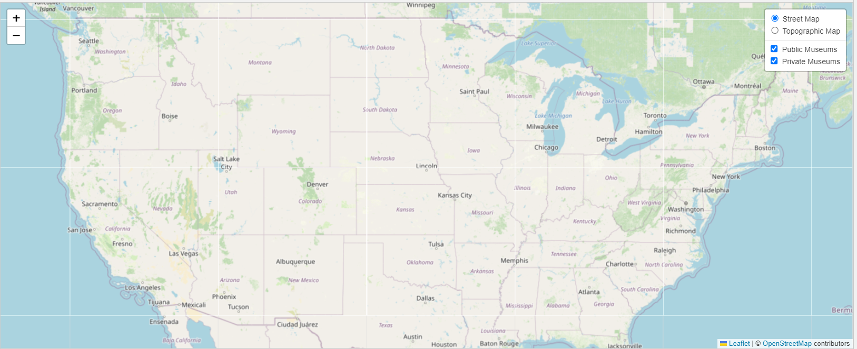
Geographical locations

Slide 5

Stats
33,000 museums
Top states with museums
Max museum and state:
(lowest count within the top 10) Min museum and state:
Top Major Cities with museums
Max museum and city
(lowest count) Min museum and city

Slide 6
Heat Mapped Ratings
Notes:
4 and 4.5 under the same colour
Each rating has a colour

Slide 7

Reviews
Ratings
A collection of xyz
Highest rated state for museums
Ranks
By State and Type
Reviews
By length of Stay
By type of exhibition, etc

Slide 8
Financial Location of Museums

Slide 9

Revenue
Largest Revenue Generation
Research based
Smallest Revenue Generation
Exhibitions only
Length of stay
By length of Stay
By type of exhibition, etc

Slide 10
Demonstration

Slide 11

Questions?

Slide 12

Thank You

